Slide 1

Building the emotionally intelligent brand
Graham Page
Head of Global Research Solutions,
Kantar Millward Brown
Graham.page@kantarmillwardbrown.com

Slide 2
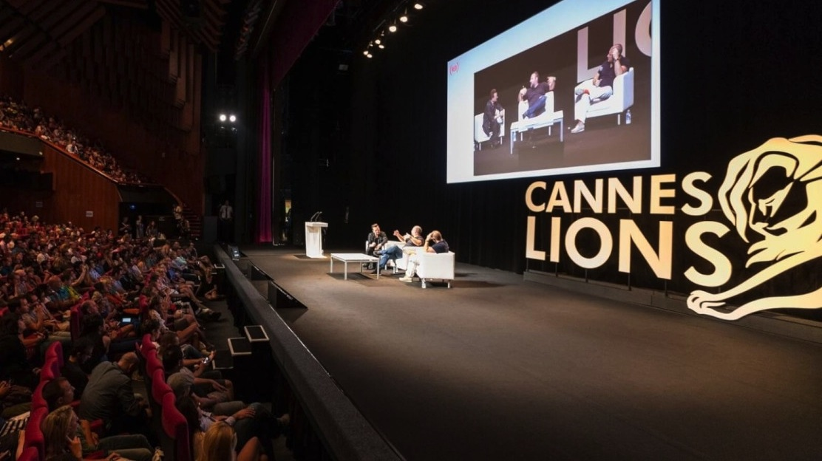
Marketers talk the talk…
Content
Experiences
Purpose
Storytelling

Slide 3
And then…
… marketers continue to send product messages
Totally
Implicit
15%
Totally
Explicit
34%
Mostly
Implicit
21%
More
Explicit
30%

Slide 4

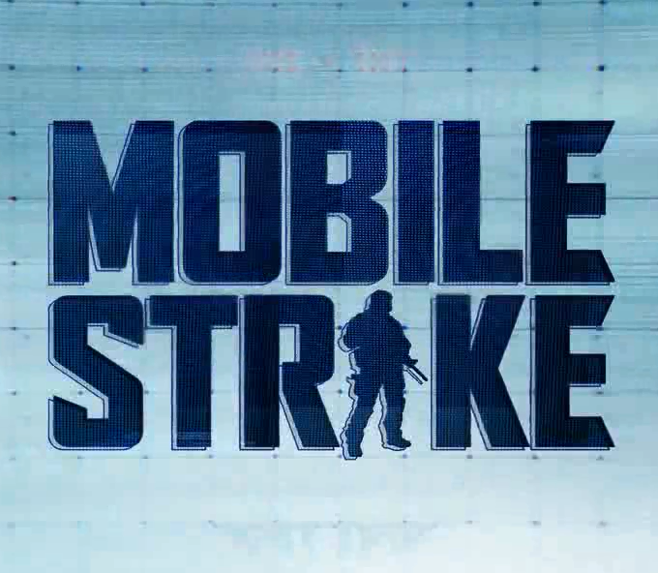
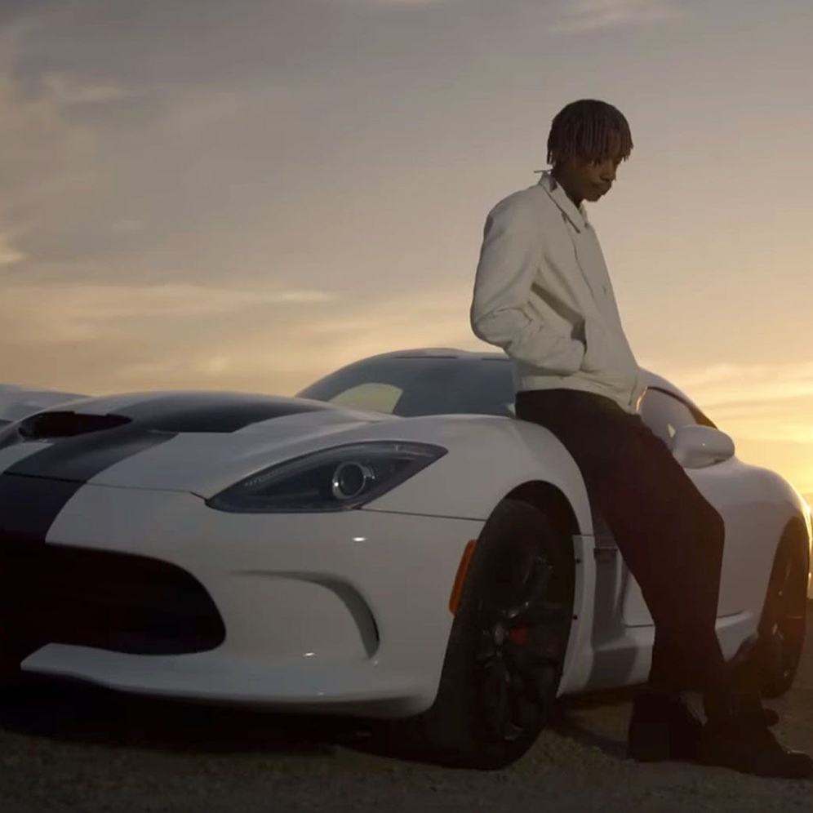
People don’t really care about brands or ads…
‘My Mutant Brain’
(Kenzo World)
6 MILLION
“Arnold’s fight’
(Mobile Strike)
106 MILLION
See You Again
by Wiz Khalifa
2.9 BILLION
Source: Kantar Millward Brown Adreaction 2016

Slide 5
The strongest brands directly affect automatic, emotional responses
Impact of brand on instinctive emotional responses
Tesco chocolate
Chocolate
Cadbury

Slide 6
Owners of strong brands that make an emotional connection over-perform the market
BRANDZ™ STRONG
BRANDS PORTFOLIO
S&P
500
MSCI
WORLD INDEX
The BrandZ™ Strong Brands Portfolio has outperformed both the S&P market index and the MSCI World Index since 2006.
105.9%
60.7%
20.1%
2006
2007
2008
2009
2010
2012
2013
2014
2015
2016

Slide 7

All touchpoints can make a difference
Presence/Salience
Appearance
Experience
Advertising
Location
Social Value
Product
Price
(Social) Media

Slide 8

GOOD STORYTELLING
DRIVES EMOTIONAL CONNECTION

Slide 9



Slide 10
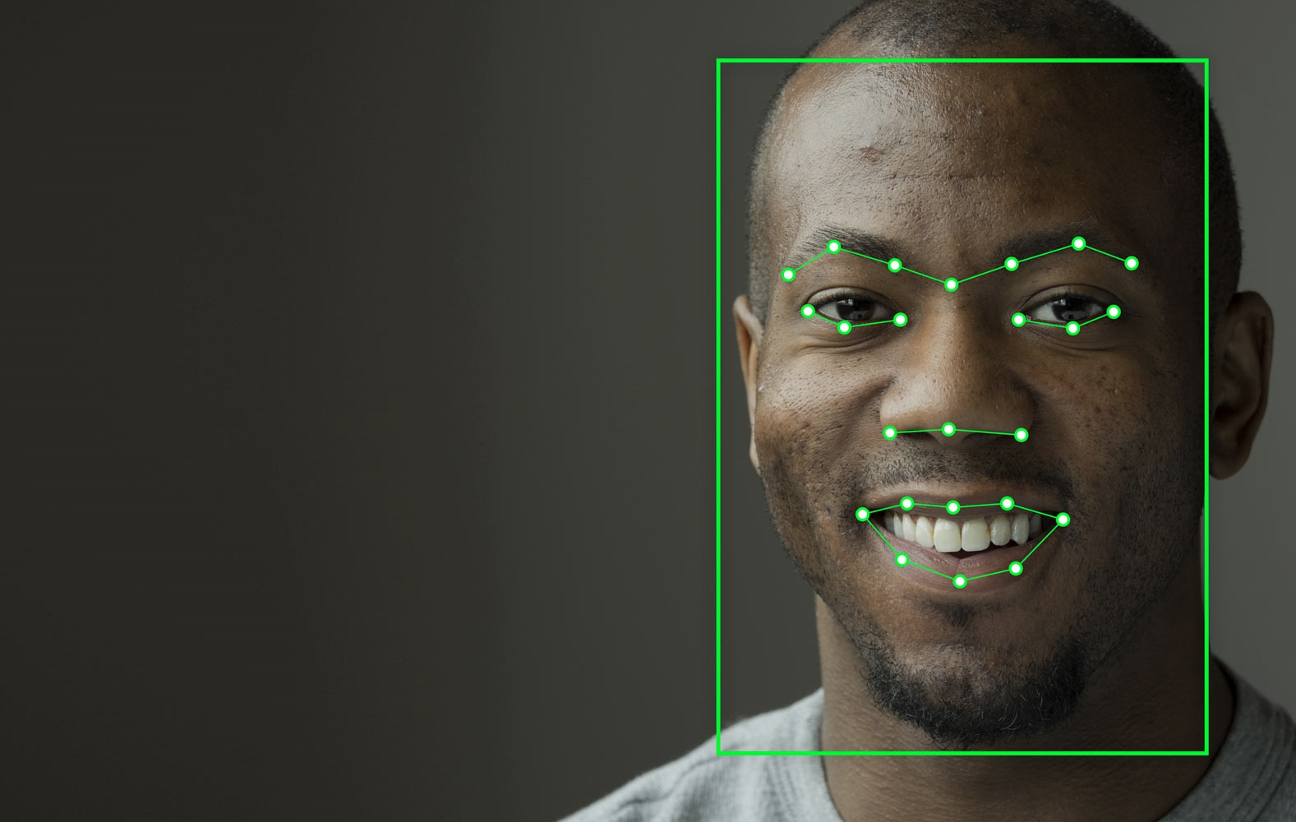




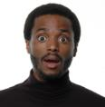



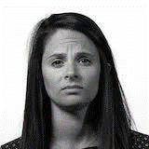
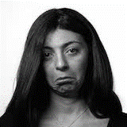

Emotion AI can help us understand pre-conscious emotional responses to ads
Records faces from webcams in natural settings. Unobtrusive, scalable and easy
Participant turns on webcam
Facial features identified
Facial expression recognition whilst watching an ad
Expression aggregation and analysis
Emotions/ cognitive states experienced
The system codes for an array of expressions most relevant to advertising
SURPRISE
DISGUST
SMILE
BROW FURROW
SENTIMENTAL
SADNESS
SMIRK

Slide 11

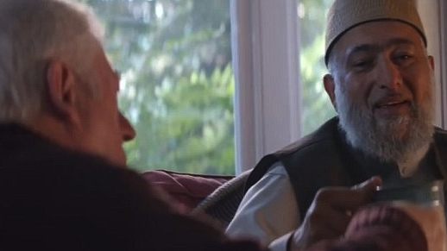
TOP 5%
EXPRESSIVENESS
TOP 5%
SMILES
TOP 15%
AFFINITY
TOP QUARTER
BRANDING
Notes:
TOP QUARTER
POWER CONTRIBUTION

Slide 12

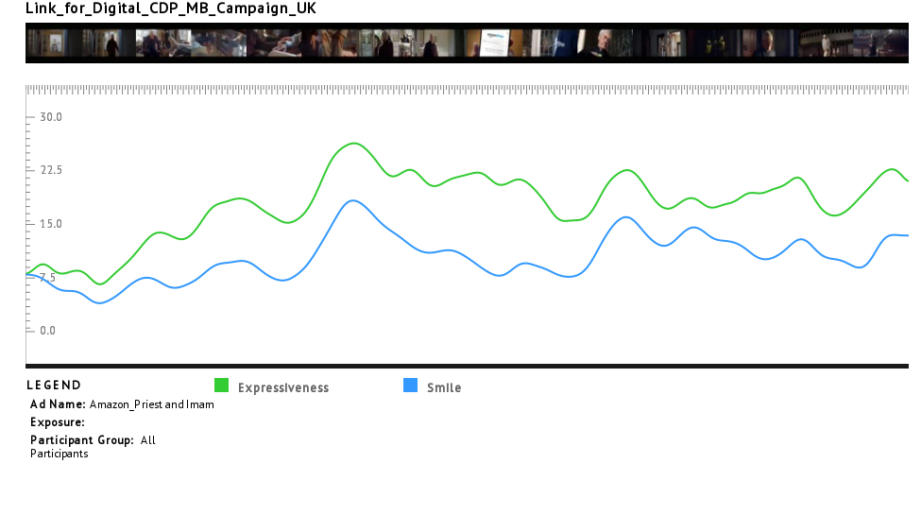
The story resonates powerfully with viewers, and shows rather than tells it’s ‘message’
‘Priest and Imam’ – Facial Coding
Priest and Imam visiting each other
Difficulty standing up
They order a gift for each other on Amazon
It’s knee pads
Both use knee pads

Slide 13
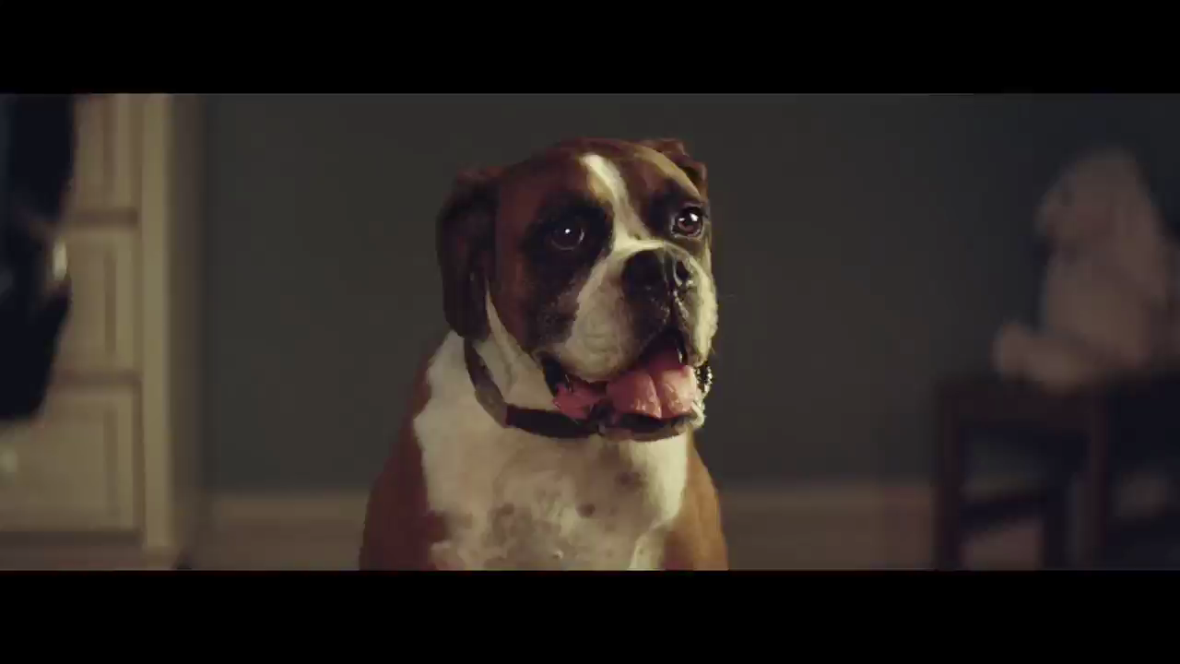

Slide 14

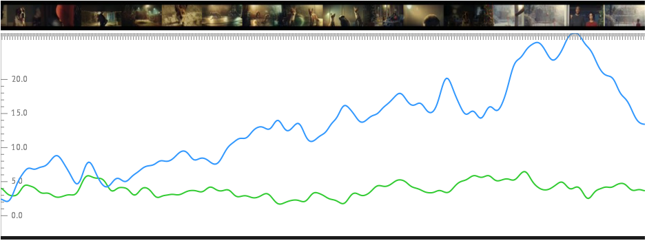
‘Buster the Boxer’ was hugely enjoyable as the growing number of smiles indicate
The campaign once again generated huge buzz and value market share increased once more
‘Buster the Boxer’ – Facial Coding – Smile & Frown
Girl is jumping on the bed
Dad is building trampoline
Foxes and other animals jumping
Dog looking at them
John Lewis
Dog overtakes the trampoline before the girl

Slide 15
Facial expressions are guide to in-market advertising success
Underlying relationship between ‘Expressiveness’ and subsequent sales uplift
0.55%
Average Volume share sales shift
0.38%
-0.06%
Bottom 25% of expressiveness
Middle 50% on expressiveness
Top 25% on expressiveness
(312 cases)

Slide 16
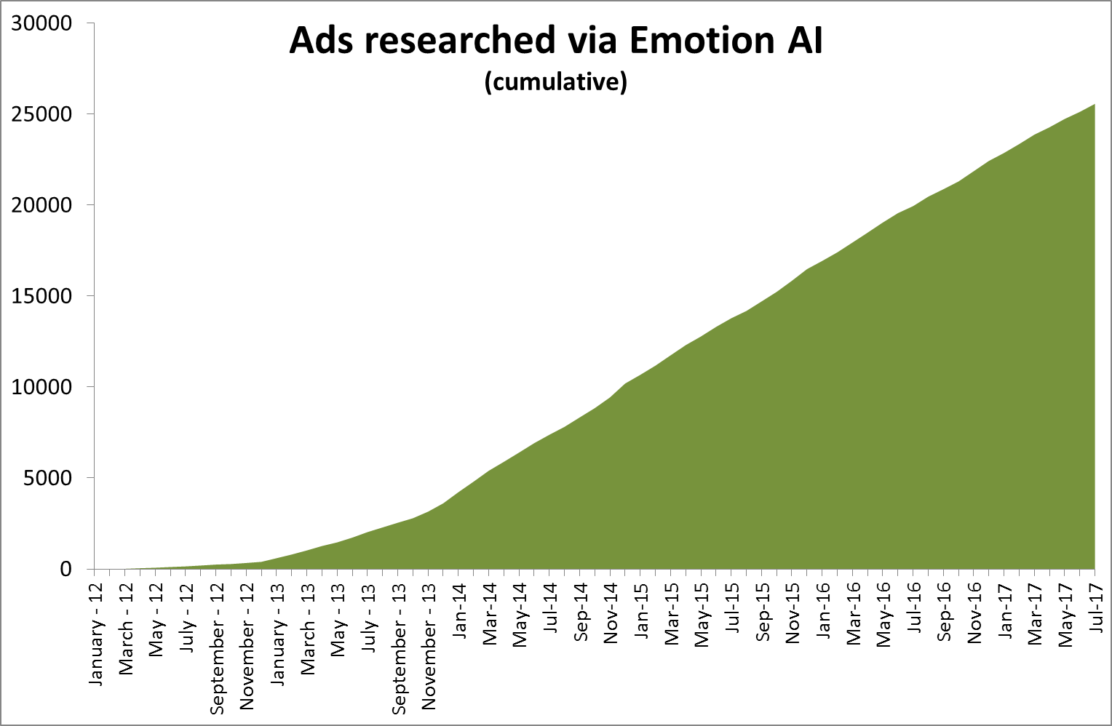
Emotion AI is transforming advertising development
Over 5 Million face videos collected
Over 25,000 ads researched world wide using facial coding
>80 countries
>800 clients
>5 billion emotion data points
Notes:
Includes Albania, Myanmar, Madagascar, Uganda and Iran

Slide 17

People remember impressions, not messages.
Respond to emotions, not facts.
Engage with stories, not arguments.

Slide 18
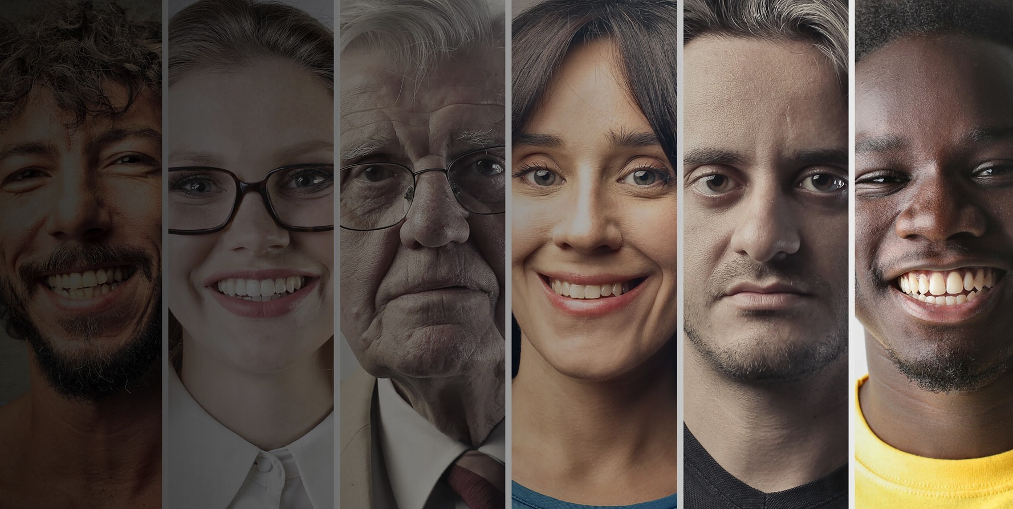
QUESTIONS?

